Slide 1
Module 4.7:
ML Data Lifecycles
Deletion, Retention, and Access
ML for Cybersecurity

Slide 2
Adversaries
Ethics
Attacker’s goals
Attacker’s capabilities
Robustness of model/feature
Privacy
Fairness
Transparency
Modules 2 – 4
Module 4
Module 2
Module 1
Module 4
Identify Goals & Collect Data
Data Representation
Modeling
Deployment
Pinpoint needs
Data acquisition
Data labeling
Data exploration
Data cleaning
Missing data
Feature selection
Consider fairness
Efficiency
Accuracy
Interpretability
Adversarial resistance
Performance
Evasion and attacks
Model drift
Impact on stakeholders
Module 3

Slide 3
Adversaries
Ethics
Attacker’s goals
Attacker’s capabilities
Robustness of model/feature
Privacy
Fairness
Transparency
Modules 2 – 4
Module 4
Module 2
Module 1
Module 4
Identify Goals & Collect Data
Data Representation
Modeling
Deployment
Pinpoint needs
Data acquisition
Data labeling
Data exploration
Data cleaning
Missing data
Feature selection
Consider fairness
Efficiency
Accuracy
Interpretability
Adversarial resistance
Performance
Evasion and attacks
Model drift
Impact on stakeholders
Module 3

Slide 4
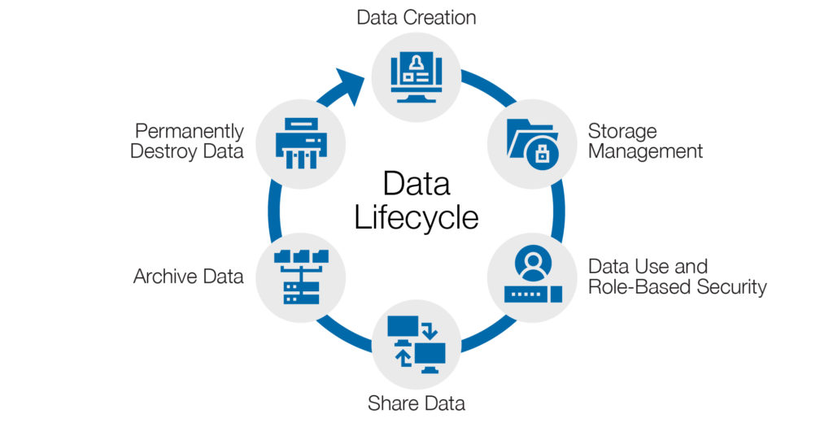
Data Lifecycles
Graphic from https://www.spirion.com/data-lifecycle-management/

Slide 5
Famous Failures

Slide 6

Google Buzz
Google Buzz was a social network that replaced Google Wave
Users automatically opted into Buzz, with weak privacy settings, based on Gmail data
Publicly disclosed on Buzz profiles people you talked to frequently on Google Chat (Gchat)

Slide 7
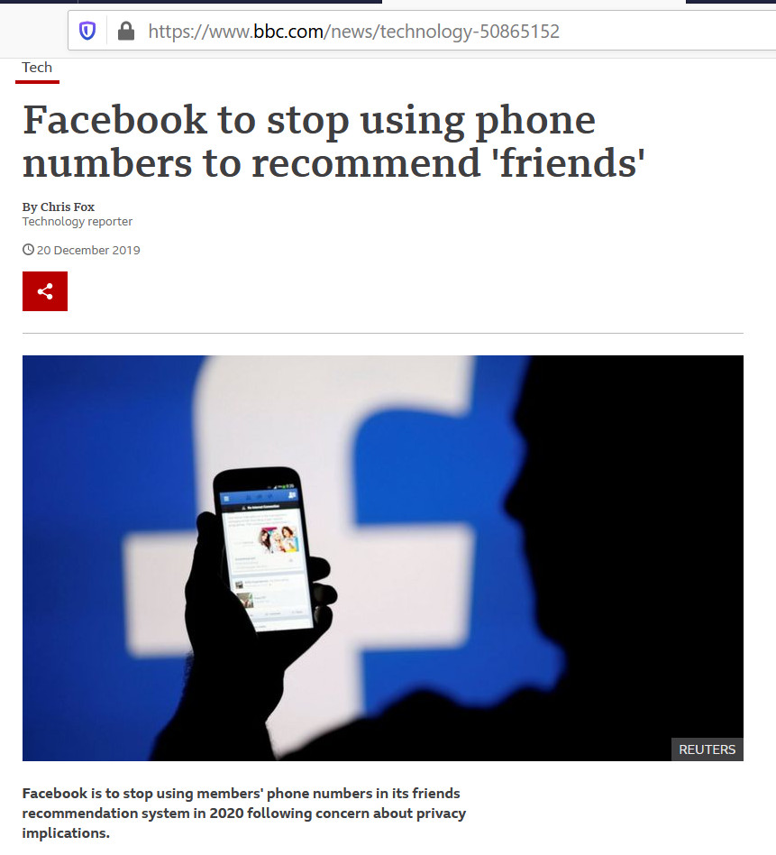
Facebook 2FA Phone Numbers
Facebook collected phone numbers for two-factor authentication (2FA)
Facebook then used those phone numbers to recommend friends and for targeting ads to specific users

Slide 8
Key Considerations

Slide 9
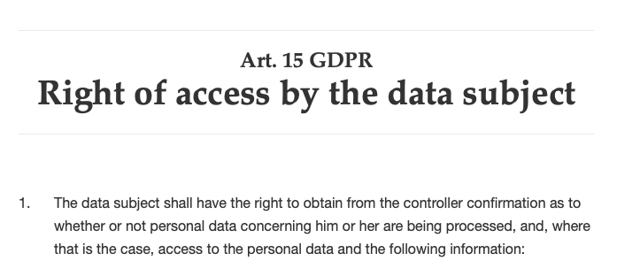
Right of Access

Slide 10
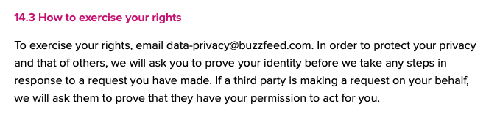
Right of Access

Slide 11

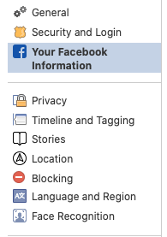
Right of Access

Slide 12
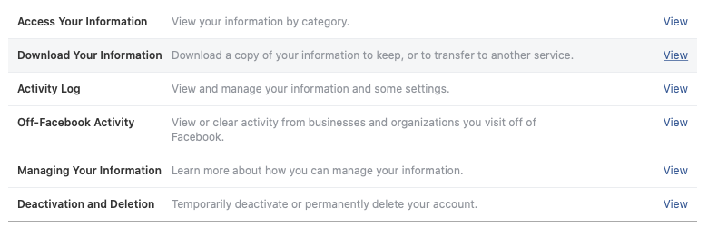
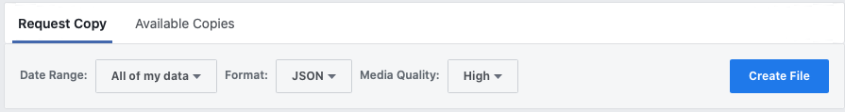
Right of Access

Slide 13
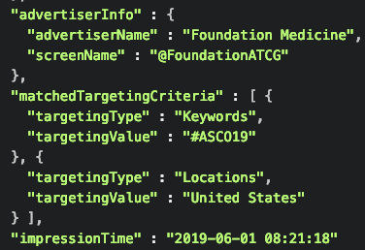
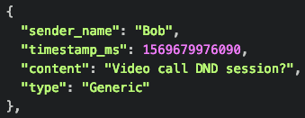
Right of Access

Slide 14
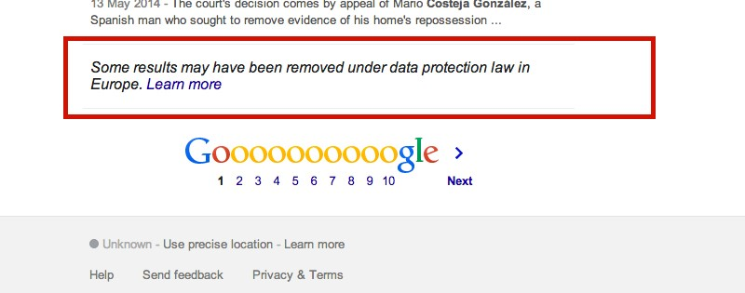
Right of Erasure

Slide 15
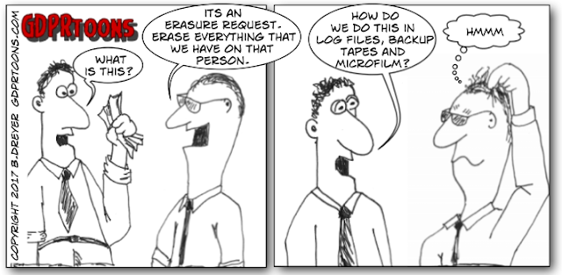
Right of Erasure
http://www.gdprtoons.com/2017/09/right-to-erasure-right-to-be-forgotten.html

Slide 16
Legal Basis

Slide 17
General Data Protection Regulation (GDPR)
Came into effect May 25, 2018 and applies to the EU
Distinguishes between data subjects, controllers (people who direct analysis), and processors (those who do the analysis)
Controller informs the “data subject in a concise, transparent, intelligible and easily accessible form”
Right of access for data subjects
Right of erasure (with some exceptions)
Right to object to processing for some purposes
Privacy by design (Article 25)

Slide 18
General Data Protection Regulation (GDPR)
Pseudonymization required for stored personal data
Data breach notification to authorities within 72 hours
Possible fines of up to 4% of worldwide turnover
Can only process data based on six lawful bases:
Consent
Contract
Public task
Vital interest
Legitimate interest
Legal requirement

Slide 19
California Consumer Privacy Act (CCPA)
Came into effect January 1, 2020 and applies to California residents
Residents of California have rights to:
Know what personal data is collected
Know whether that data is sold
Refuse the sale of personal data
Access their data
Request erasure of their personal data
Not be discriminated against for exercising these privacy rights
Fine of $7,500 for intentional and $2,500 for unintentional violations

Slide 20
Business Applications

Slide 21
ML Cybersecurity Under GDPR/CCPA
For how long do we need to keep data for retraining models?
Do we need to keep all the data? Are we permitted to keep the data? Can we use transfer learning?
How do we balance data-erasure requests with robust backups?
How do we authenticate data-access requests? In what format is this data provided?
What makes an ML workflow compliant with GDPR and CCPA?
Does this meet all user needs / desires?

